Slide 1
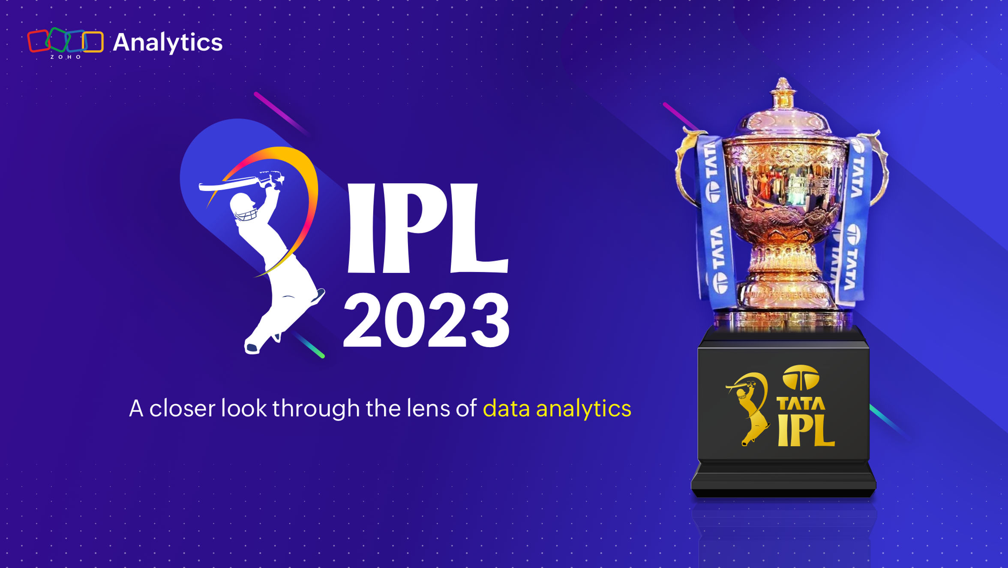
“ IPL CRICKET SCORE PREDICTION ”

Slide 2
Introduction.
Cricket is one of the most popular sports in the world, viewed by majority of world’s population. It is a game played between two teams of eleven players each. With the advent of statistical modelling in sports, predicting the outcome of a game has been established as a fundamental problem. The game of cricket is played in three formats - Test Matches, ODIs and T20s. We focus our research on T20s, the most popular format of the game. With this article, we embark on predicting the outcome of an Indian Premier League (IPL) cricket match.
In an IPL season there may be a minimum of 8 to 10 teams playing and each team plays with remaining all teams for a minimum of two times. Initially toss plays as a crucial factor in deciding the winner of the match. Toss winning team can wish to either field or bat. The team batting first will try to pose as many runs as possible in their 20 overs in order to set a target. The team batting second need to chase the target in order to win the game with wickets in hand.
we have seen projected scores at different intervals being displayed on our television screens. Projected scores are completely based on runs scored and looking at different totals at the end of an innings, using various run rates. For example, if a team’s score is 100 at the end of 10 overs. There could be four variations of projected scores:
• Current run-rate: 200
• 6 per over: 160
• 8 per over: 180

Slide 3
Existing System.
Feature Engineering these features could include batting averages, strike rates, team composition, past performance at a specific venue, and head-to-head statistics between teams.
Sentiment Analysing social media sentiments, expert opinions, and fan discussions can provide insights into team morale, player form, and other intangible factors that might influence match outcomes.
Weather conditions and pitch characteristics significantly affect cricket scores. Systems consider weather forecasts and analyse historical data about pitch behaviour to predict scores.
Some systems integrate live data during matches to adjust predictions in real-time based on the game's progress, player performance, and changing conditions.

Slide 4
SCOPE OF THE PROPOSED SYSTEM
Cricket score prediction is an area where the first innings score of a cricket match is predicted using some techniques. There are various systems and prediction methods used to predict the cricket score of the ODI and the T20 cricket matches. CRR method is widely used to predict the score of the cricket match.
In the CRR method, the number of runs scored in an over is multiplied by the total number of overs in an innings. This method only focuses on the runs made in an over but it does not focus on the different parameters.
This method can only predict the score based on the current score and not based on the various parameters. We are working to improve on the predictions by considering different parameters and to improve the accuracies of the existing systems.
We are considering the T20 matches for the score prediction and we will be focusing on the live cricket score prediction. Our aim is to predict the first innings score of the live IPL match.
We will be predicting the score of an IPL match by considering various factors like runs scored, overs bowled, wickets taken, etc. The reason behind selecting these features is that we need to build a model that can understand the dynamicity of the cricket game.

Slide 5
Technology Used
Description | Required
Processor | I5 11th generation
Ram | 8 GB
Hard Disk | 1 TB
Monitor | 15 inches Colour Monitor
Keyboard | 122 Keys
Operating System | 64 Bit
Hardware requirements :
Front-end | Html, CSS, JavaScript
Back-end | Python, Flask
Models | Machine Learning (Ridge Regression model)
Platform | Windows 10
Software requirements :

Slide 6
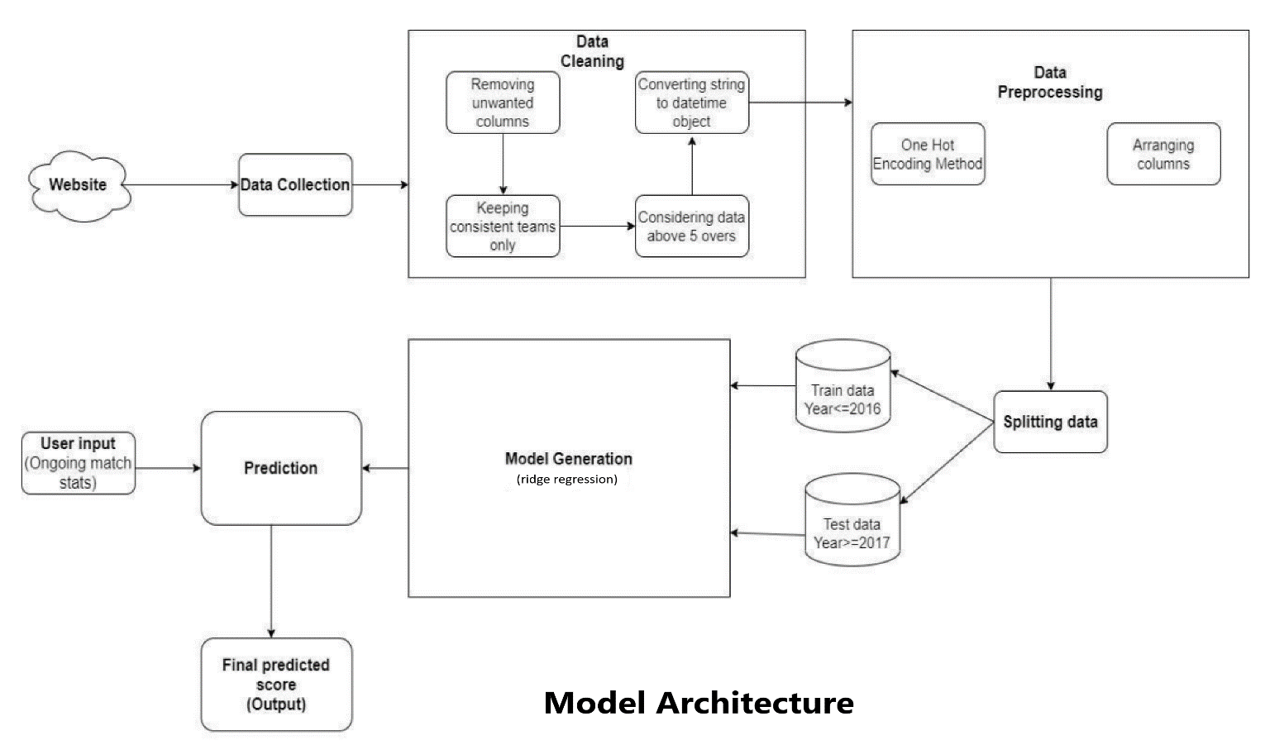
MODEL ARCHITECTURE

Slide 7
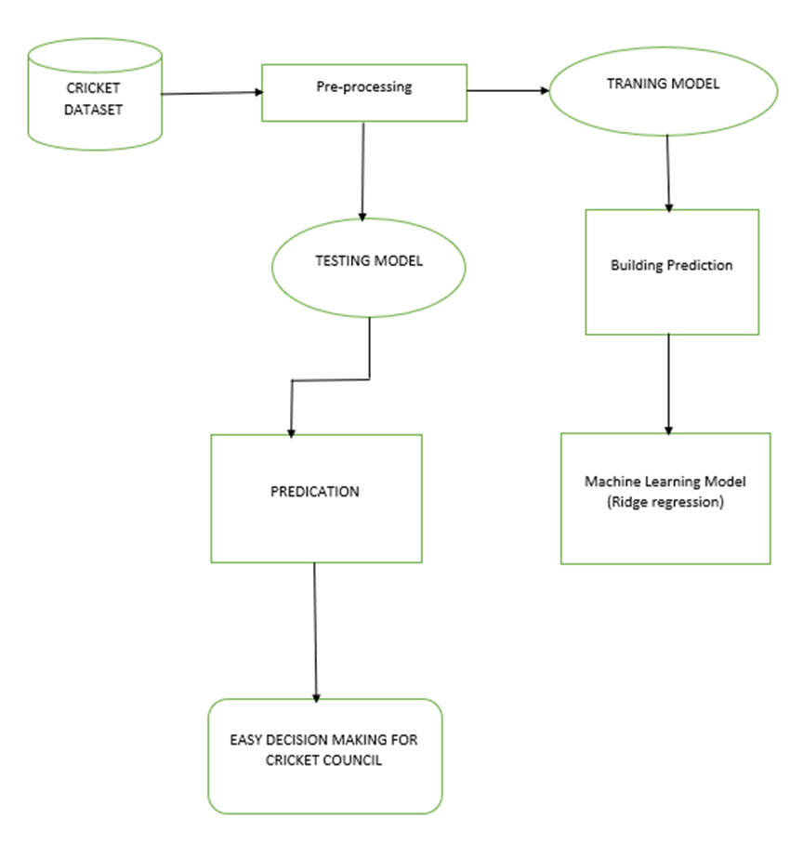
System Design
This System Design Diagram shows us how streamline of the data & how it can be used for easy decision making for the cricket council. It shows flow of the system & components in the system.

Slide 8
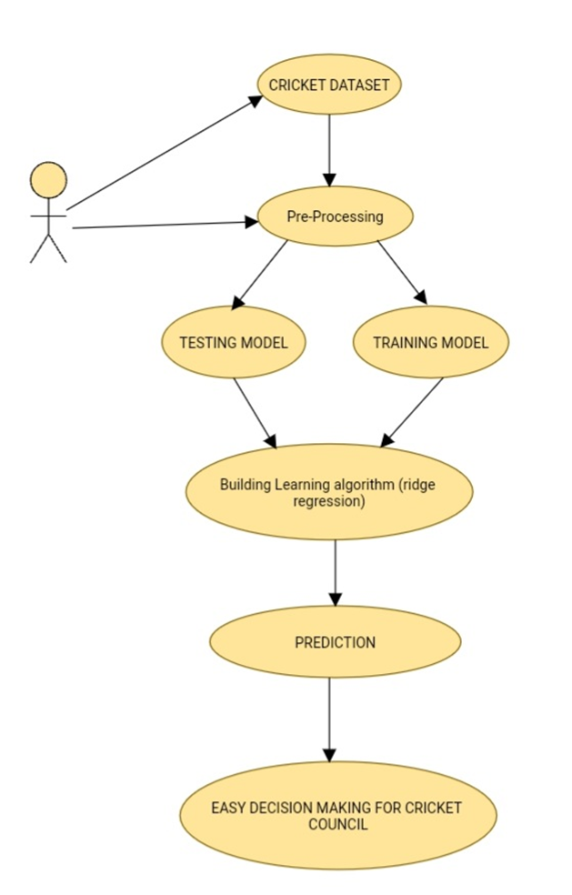
Use - Case Diagram
This use-case diagrams shows us how ML Model is chosen & it is saved. Later it is used by the flask app where the end user inputs his parameters & App predicts based on his parameters.
•User: User will input the features.
•Pre-Processing: Pre-Processing part of the dataset.
•Training &Testing: It will depict training & testing.
•ML Model: Building an ML Model.
•Flask App: End Product of Cricket Score Prediction.

Slide 9
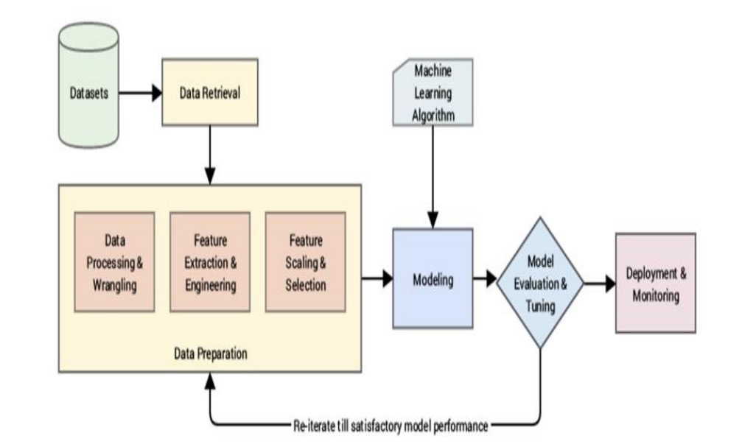
Activity Diagram
Above Activity Diagram depicts which phases are implemented during a machine learning project. The typical phases include data collection, data pre-processing, building datasets, model training and refinement, evaluation, and deployment to production. You can automate some aspects of the machine learning operations workflow, such as model and feature selection phases, but not all.

Slide 10
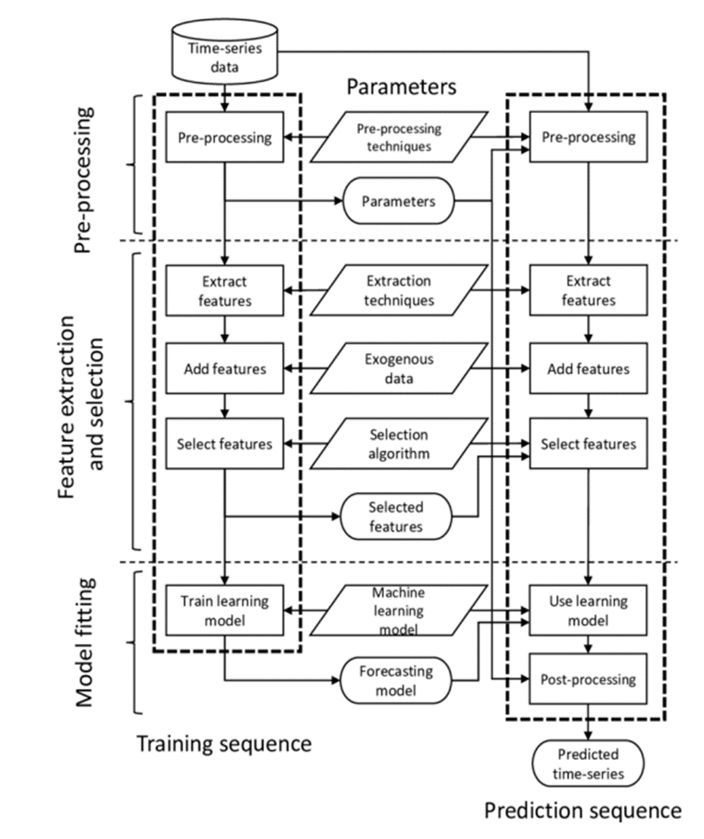
DFD Diagram
This data flow diagram (DFD) maps out the flow of ML Model for any process or system. It uses defined symbols like rectangles, circles and arrows, plus short text labels, to show data inputs, outputs, storage points and the routes between each destination.

Slide 11
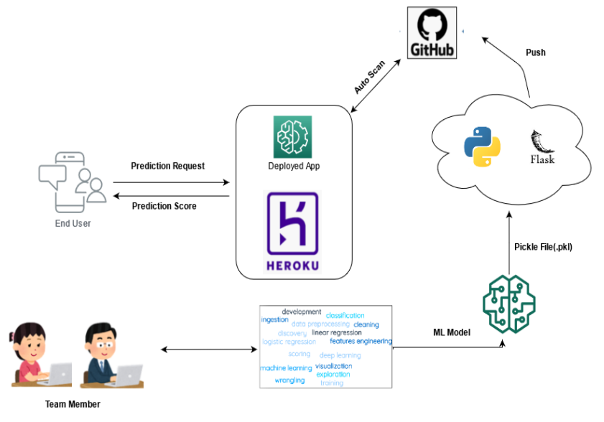
DEPLOYMENT DIAGRAM
Above Diagram represents us that how a client will interact with out cricket dataset.
• templates: - This folder contains the html files (home.html, result.html) that would be used by our main file (app.py) to generate the front end of our application.
• app.py: - This is the main application file, where all our code resides and it binds
everything together.
• requirements.txt: - This file contains all the dependencies/libraries that would be used in the project.
• model.pkl: - This is our classification model, that we would be using, in this case it is a Logistic Regression Model, which I had trained already.
• Procfile: - This is a special file that would be required when we would be deploying the application in a public server.

Slide 12
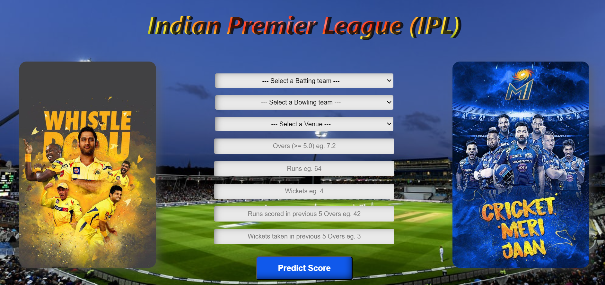
USER INTERFACE DESIGN
Above image depicts the final UI for our cricket score prediction model. The model would run on the local host in our system and according to the inputs provided it would process the algorithm in the Backend.

Slide 13
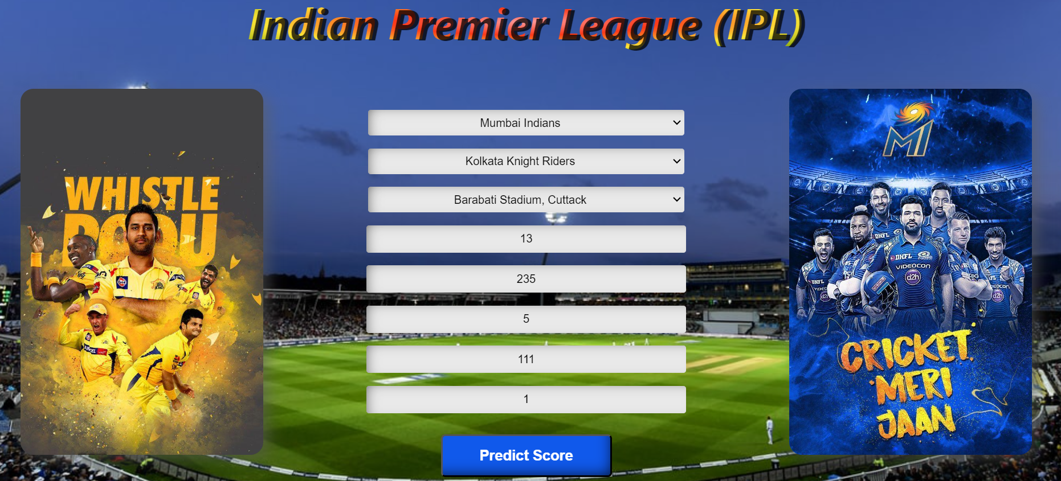
USER INTERFACE DESIGN
Above image depicts how we will give the input to our cricket score prediction model.

Slide 14
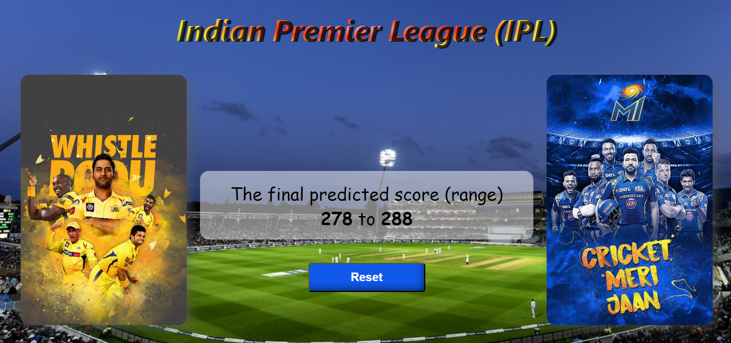
USER INTERFACE DESIGN
Above model depicts how our app will show the predicted score. This score has been calculated using the inputs shown/given in the previous image, After the substitution, the model will process the algorithms in the backend and will provide with the most accurate score calculated by it.

Slide 15
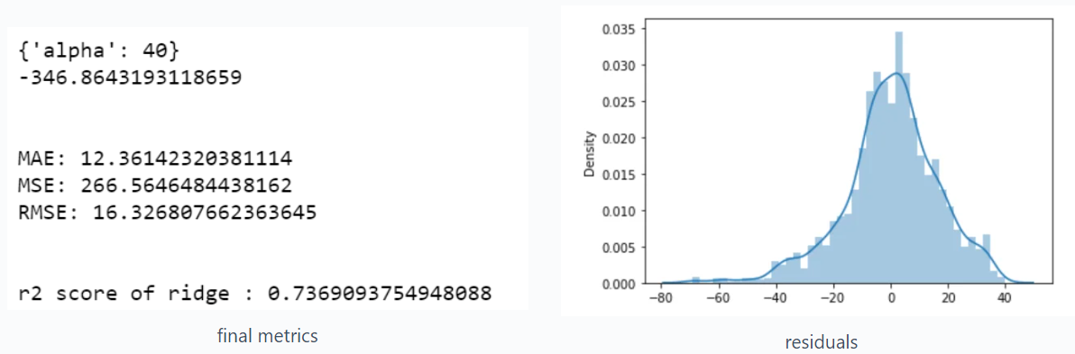
Accuracy of model
We also tried Linear regression but that was overfitting to the next level, that’s why I went with Ridge Regression because it prevents our model from overfitting.
Lasso regression was also giving similar results as ridge regression.

Slide 16
PROPOSED ENHANCEMENT
We studied ridge regression approaches in this project to predict the first innings score of a live IPL match. From the results, we can conclude that the ridge regression Machine algorithm has the highest accuracy of the prediction. So, we are using the ridge regression Machine algorithm for the prediction purpose. Teams can use Current Run Rate (CRR) to predict the final score even before the 20 overs have been bowled. So, the teams can know when to accelerate and when to play aggressively to increase the run rate while putting a target. This model can predict the score by putting the current ongoing live match stats and predict the results beforehand by using their previous records. Hence, this can be used by cricket lovers for predicting the final score of a live IPL match.
Future Scope In the future, we can implement a model for predicting the chasing probability. We can work on improving the accuracy of the model used in this project. Factors like all venues, pitch, and the opponent team can be considered for the prediction.

Slide 17
Drawbacks
One of the biggest drawbacks of the Indian Premier League (IPL) in developing cricket is that it can create an imbalance in the cricketing ecosystem because, IPL has a huge amount of money involved in the game.
Variability in Performance: Cricket is highly unpredictable, and player performance can vary widely from match to match due to various factors like weather conditions, injuries, and pressure situations.
Complexity of the Game: Cricket involves multiple variables such as pitch conditions, player strategies, team dynamics, and the element of chance (like toss outcomes). It's tough to model all these variables accurately to predict scores reliably.
Limited Data: Limited access to detailed player data, especially for newer or less experienced players, can hinder accurate predictions.
Human Element: The human element, including the emotions, adrenaline, and decision-making abilities of players, coaches, and the influence of the crowd, is tough to quantify accurately in predictive models.
Model Complexity: Building a reliable predictive model for cricket scores involves complex statistical and machine learning techniques. Balancing model complexity with accuracy is challenging and may lead to overfitting or underfitting problems.

Slide 18

…Thank You…

